Slide 1
Women and Economic Statecraft:
The Negative Impact International Economic Sanctions Visit on Women
POS 6933 MLE
Xiao Sun
Fall 2021

Slide 2
Introduction
A. Cooper Drury and Dursun Peksen. "Women and economic statecraft: The negative impact international economic sanctions visit on women." European Journal of International Relations 20, no. 2 (2014): 463-490.
Two arguments
economic sanctions are likely to worsen women's economic , social, and political status
﻿negative impact of economic coercion on women’s well-being is conditioned by the wealth of a targeted country
Scope and Datasets
Global analysis: all countries from 1971-2005. Dataset: 1970-2004.
Cingranelli–Richards (CIRI) Human Rights Database, World Development indicators database of the World Bank, Hufbauer et al.’s economic sanction data, Armed Conflict Database, Polity IV dataset, etc.
Notes:
address the consequences of sanctions on women’s well-being.
﻿women in poor countries are hit the hardest by economic sanctions

Slide 3
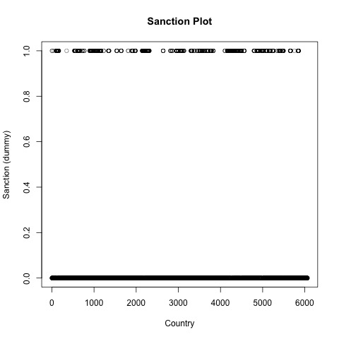
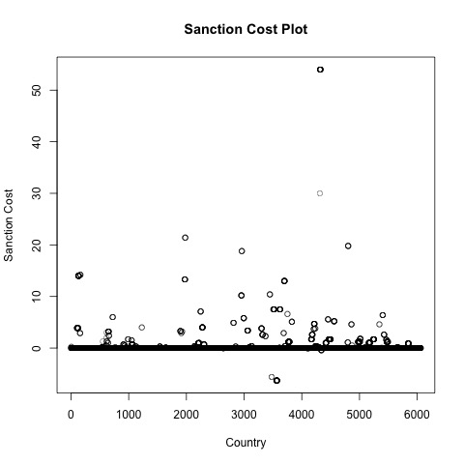
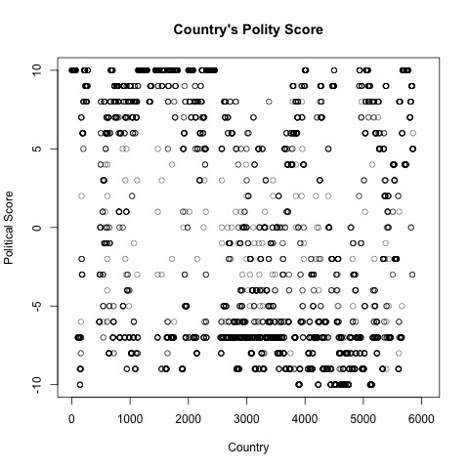
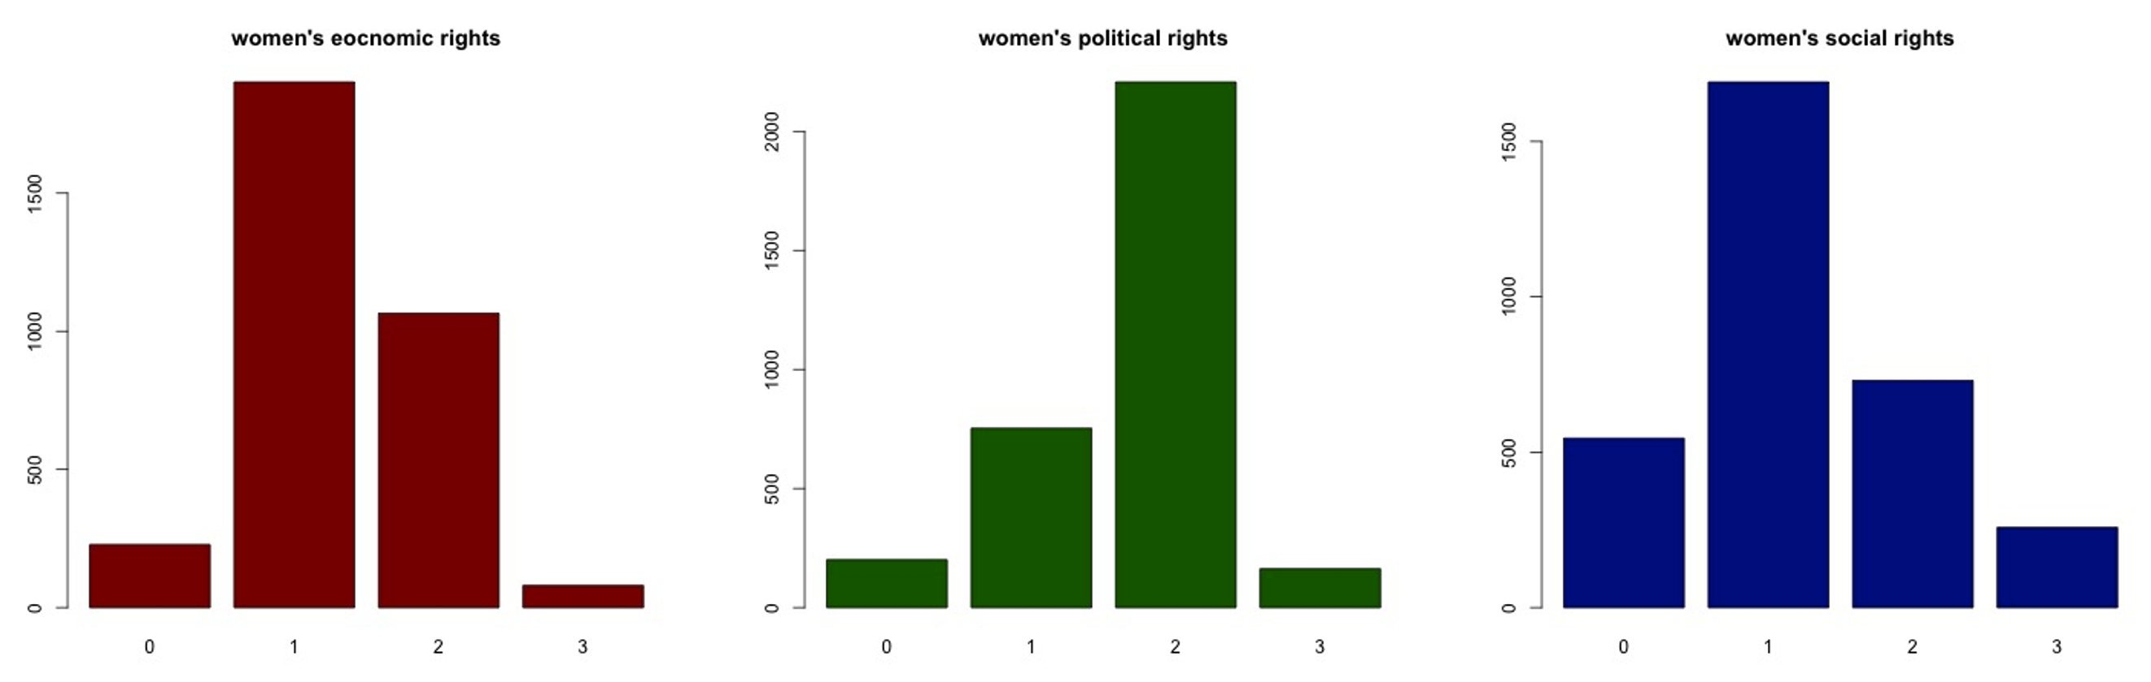
Method AND MEASUREMENT
Models: ordered logit model and time-series and cross-nation analysis
DV: women’s status
IVs: economic sanctions, sanction costs, multilateral sanction, humanitarian sanction
Control: GDP Per Capita, democracy, economic openness, civil war and interstate war, peace years, region-specific effect
Economic rights + female labor participation
Social rights
Political rights
Notes:
Ordinal variables: 0-3. 4 levels. 0: extreme violations of women‘s rights, 3: no major violation of women's rights
region-specific effect: Asia and Pacific, Latin America/Caribbean, Middle East/North Africa, sub-Saharan Africa, and North America/Europe (reference category).
Mistake: country in a specific year instead of country.
Women’s Economic Rights consists of several internationally recognized rights including: equal pay for equal work; non-discrimination by employers; equality in hiring and promotion practices; job security (maternity leave, unemployment benefits, no arbitrary firing or layoffs, etc.); free choice of profession or employment without the need to obtain a husband or male relative’s consent; the right to gainful employment without the
need to obtain a husband or male relative’s consent; the right to be free from sexual harassment in the workplace; the right to work at night; the right to work in occupations classified as dangerous; and the right to work in the military and the police force (Cingranelli and Richards, 2006: 77).
Women’s Social Rights is coded based on the extent of respect for several internationally recognized rights. These rights include: the right to participate in social, cultural, and community activities; the right to an education; the right to equal inheritance; the freedom to choose a residence/domicile; freedom from female genital mutilation of children and of adults without their consent; freedom from forced sterilization; the right to enter into marriage on a basis of equality with men; the right to travel abroad; the right to obtain a passport; the right to confer citizenship to children or a husband; the right to initiate a divorce; and the right to own, acquire, manage, and retain property brought into marriage (Cingranelli
and Richards, 2006: 85)
Women’s Political Rights comprises several internationally recognized rights including: the right to vote; the right to run for political office; the right to hold elected and appointed government positions; the right to join political parties and the right to petition government officials (Cingranelli and Richards, 2006: 71).

Slide 4
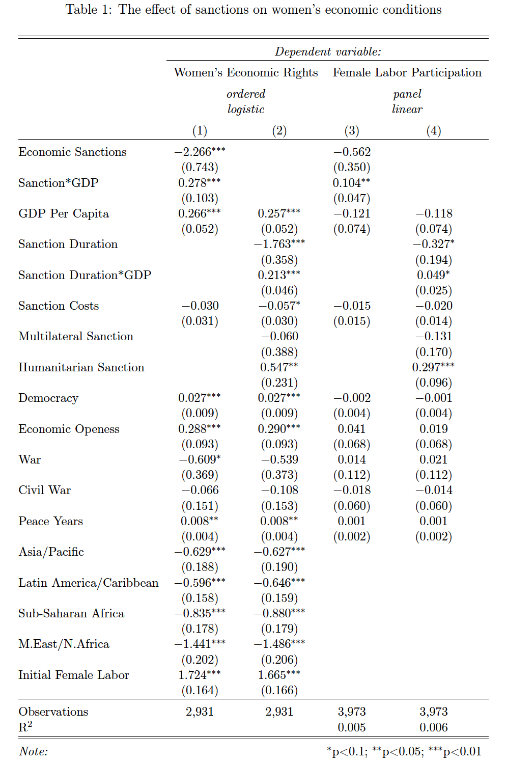
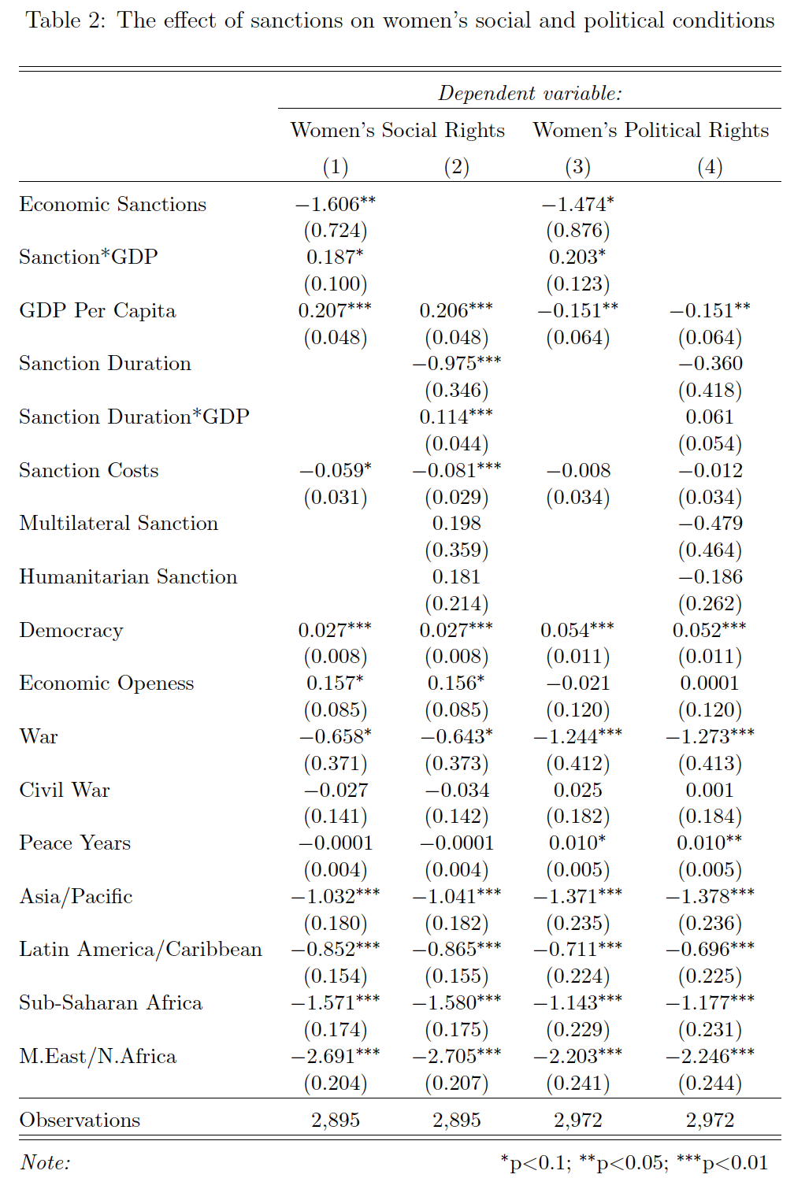











replication
Notes:
Texreg()
Table 2 results are the exactly same as the original table
Economic sanctions have negative and significant effect on women’s economic, social, and political rights
GDP per capita has positive and significant effect on women’s economic, social rights but not on political rights.

Slide 5
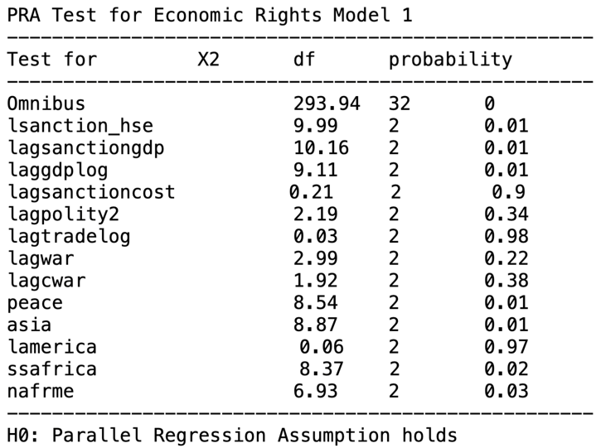
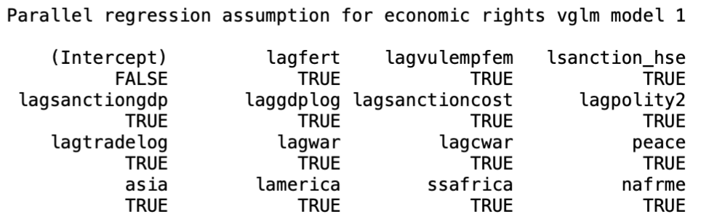
IMPROVEMENT
Ordered logit
Violate PRA
Omitted variables
Fertility rate
Female vulnerable employment (drop or not?)
Dataset
extension
﻿vector generalized linear models (VGLMs)
Note: the correlation is -0.36 between female vulnerable employment rate and women’s economic rights
Notes:
﻿vector generalized linear models (VGLMs)
Total fertility rate represents the number of children that would be born to a woman if she were to live to the end of her childbearing years and bear children in accordance with age-specific fertility rates of the specified year.
Vulnerable employment refers to the sum of contributing family workers and own-account workers. They are less likely to have formal work arrangements and are therefore more likely to lack decent working conditions, adequate social security and ‘voice’ through effective representation by trade unions and similar organizations.
Causal relationships? Is it conceptually part of economic rights?

Slide 6
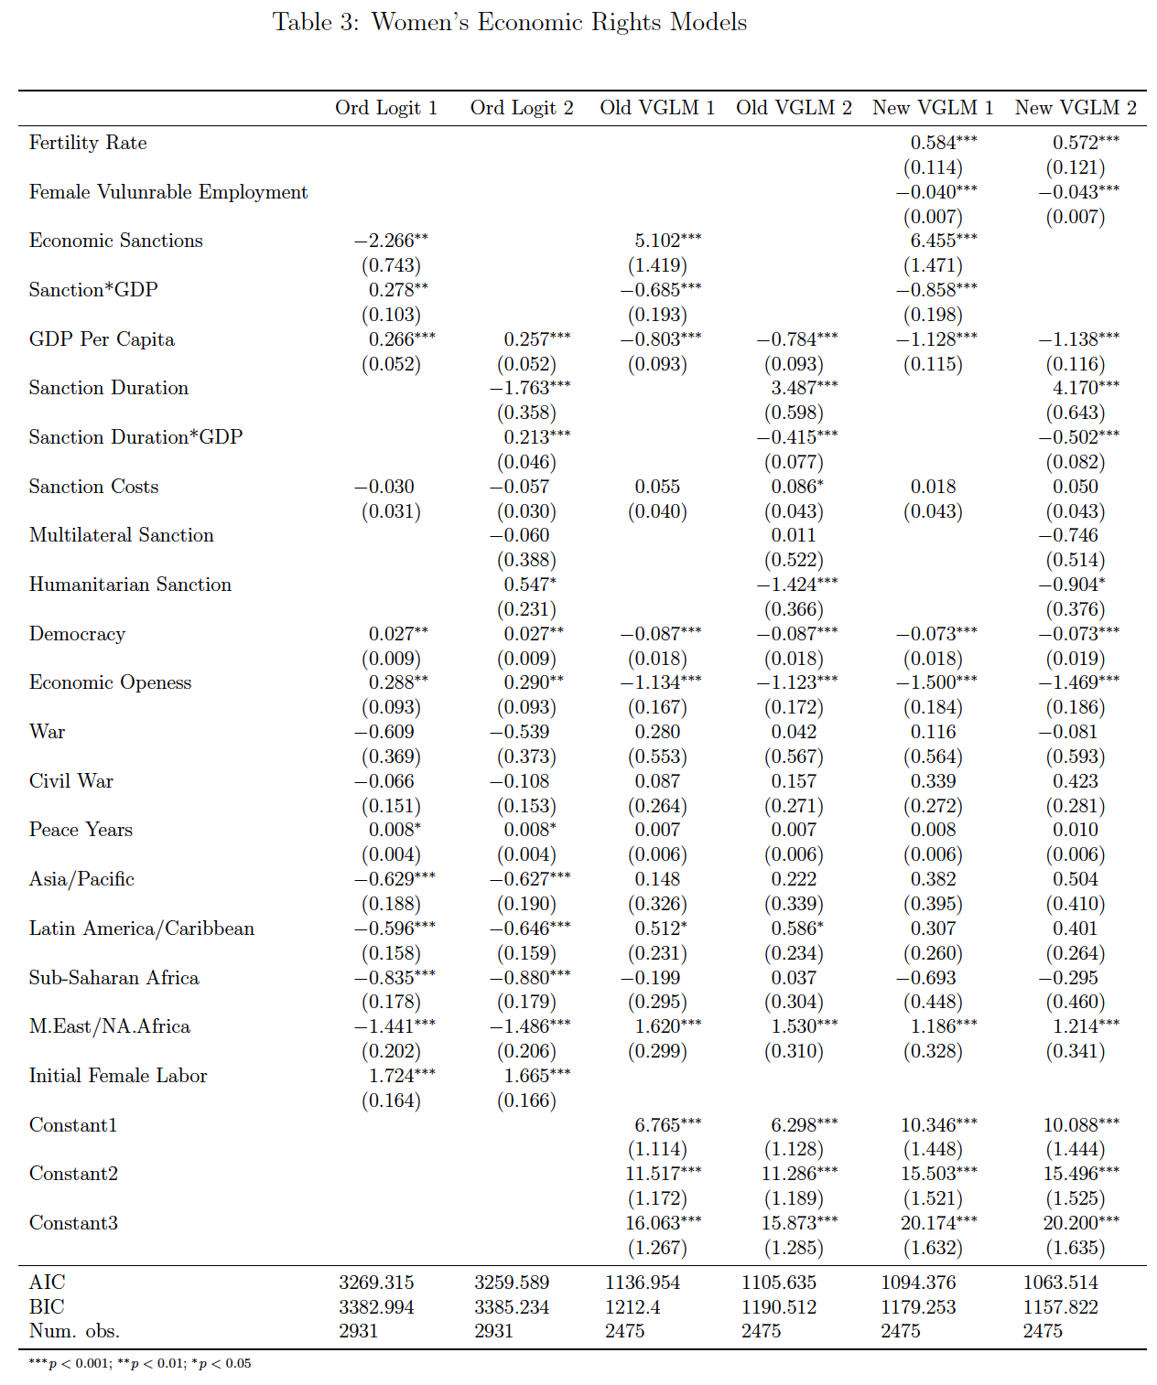
Models' comparison
New models produce
opposite results.
Dataset has some changes
But after I use different
datasets in VGLM models,
the results still contradict to
this paper’s findings.
Notes:
GDP per capital has significant and negative effect, different from authors‘ hypotheses. This effect is also negative for my other three models but only positive for social rights model 2. This effect is not stable

Slide 7
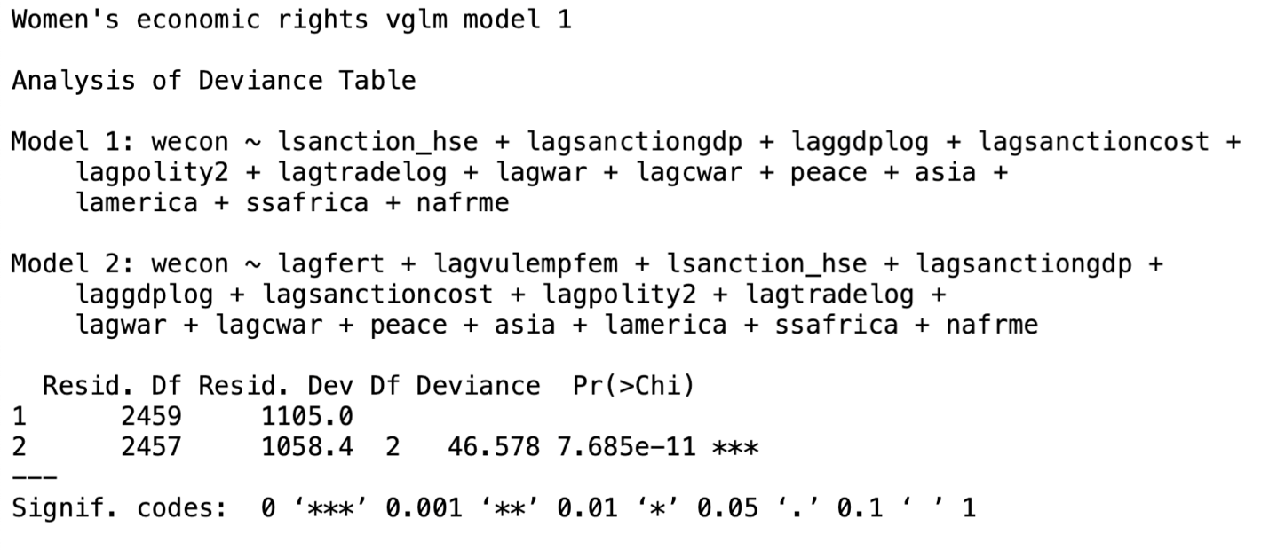
Likelihood ratio test
anova(modeco1.vglm, modeco1.vglm.new, test.statistic="LR", type = 'I', error.estimate=c("pearson", "dispersion", "deviance"))

Slide 8
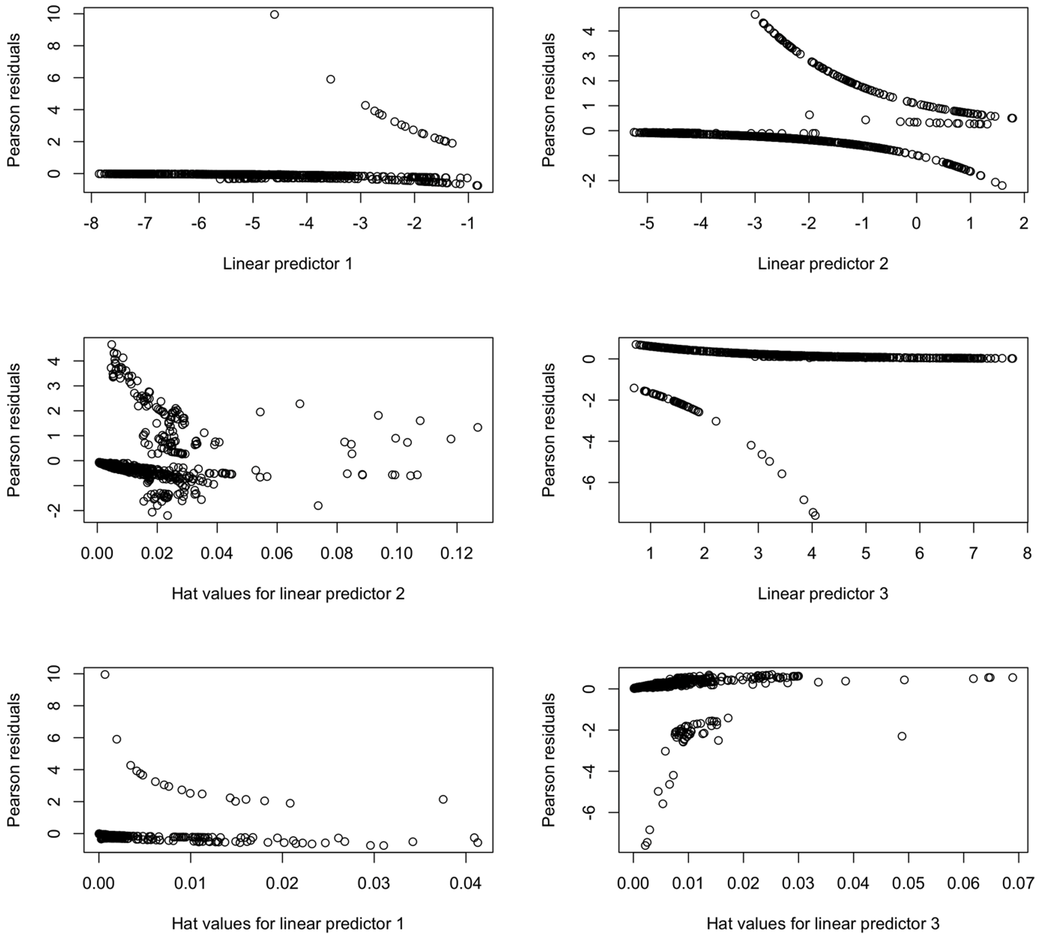
Residual plots
Economic rights, model 1
Thomas Yee
plotvglm(modeco1.vglm.new, which = "(All)")
The Pearson residuals vs. linear predictors
The Pearson residuals vs. the hat values
Obvious pattern, so variables or models are not good enough.
Notes:
Thomas W. Yee, Vector Generalized Linear and Additive Models With an Implementation in R, Springer 2015.

